Slide 1

cybersecurity quiz!
Test your knowledge on the basis of cybersecurity! click on the correct answers to advance through the quiz.
Instructions :
Click on an answer to proceed. Each answer will take you to anew slide. Let's get started !

Slide 2
Question 1: “What is Cybersecurity?”
The process of managing software updates.
Protecting computer systems and networks from digital attacks.
Writing code for software applications.

Slide 3

Oop’s, that’s incorrect.
Cybersecurity focuses on protecting computer systems networking from digital attacks.

Slide 4
Cyber Security
Network Security
Infrastructure security
Cloud security
Data security prevention
Information Security
Application security
Correct
Cybersecurity is all about protecting digital systems from unauthorized access and attacks

Slide 5
Question 2: “What is two-factor authentication (2FA)?”
method of requiring two passwords.
B) A security feature that uses two forms of identification.
C) A technique to hide your identity online.

Slide 6

Correct
2FA provides extra security by requiring two forms of verification.”

Slide 7
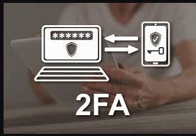
Oop’s that’s Incorrect!
Two-factor authentication combines two different methods to verify identity.

Slide 8
Question 3: “What is the best way to create a strong password?”
A) Use a mix of uppercase, lowercase letters, numbers, and symbols.
B) Use your name and birthdate.
C) Keep it short and easy to remember.

Slide 9
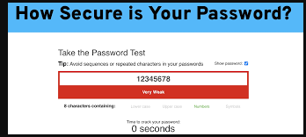
Correct
A strong password uses a combination of different characters and is harder to crack.

Slide 10
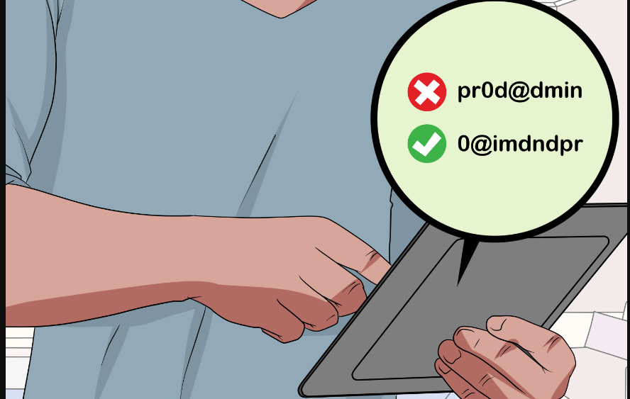
Oop’s that’s Incorrect!
.Personal details and short passwords are easier to guess or hack.

Slide 11
“Congratulations ! You’ve Completed the Quiz”
“Thank you for participating in our Cybersecurity Quiz!”

